Slide 1
Welcome To The Presentation

Slide 2
TITLE
English To French Neural Machine Translation
Using Transformer

Slide 3
SUPERVISED BY
Annajit Alim Rasel Department of CSE BRAC University

Slide 4
PRESENTED BY
Moh. Shohanur Rahman
Id: 22166040
Department of CSE
BRAC University
Saib Ahmed
Id: 22166032
Department of CSE
BRAC University
Shah Sufian Noor Mahady
Id: 22166030
Department of CSE
BRAC University

Slide 5
ABSTRACT
Neural Machine Translation is a type of deep learning model that can be used to translate between languages. Sequence-to-sequence models, like the Transformer, are particularly effective at this task because they use attention to speed up training. In this project, a Transformer model was used to create an English-to-French language translator. This model can also be applied to other languages and can be used to create a translator chatbot.

Slide 6
INTRODUCTION
Neural machine translation is a newer approach to machine translation that involves training a single network to translate between languages. Most models use an encoder-decoder structure, but this can have difficulty handling long sentences. An extension to the encoder-decoder model has been proposed that adaptively chooses a subset of encoded vectors while decoding, improving translation performance and producing plausible alignments. This approach has been particularly effective with longer sentences and has achieved performance comparable to or close to conventional phrase-based systems on English-to-French translation.

Slide 7
LITERATURE REVIEW
Researchers have used various approaches and techniques, including seq-to-seq recurrent neural networks with long-term memory cells and the Transformer model, to analyze language translation using machine learning. A single deep learning model can be designed to jointly learn from multiple tasks and domains using a multimodal architecture with shared parameters and computational blocks from different domains. The tensor2Tensor framework and Transformer model have been used in experiments for English-to-Czech machine translation, with larger batch sizes leading to better results. It is important to match the features of the data to be learned with the capabilities of the machine learning algorithm in order to select the appropriate algorithm for a task.

Slide 8
PRELIMINARY CONCEPTS
In this project, we will use the BERT algorithm and concepts of RNNs and LSTM neural networks.
RNN :
A Recurrent Neural Network (RNN) is a type of neural network where the output from the previous step is fed as input to the current step, allowing it to remember and use information from previous inputs in the current task. RNNs have a "memory" in the form of a hidden state that remembers information about a sequence, and they use the same parameters for all inputs to perform the same task on all inputs. This can reduce the complexity of increasing parameters and memorizing each previous output by giving each output as input to the next hidden layer, allowing all hidden layers to be joined together in a single recurrent layer.

Slide 9
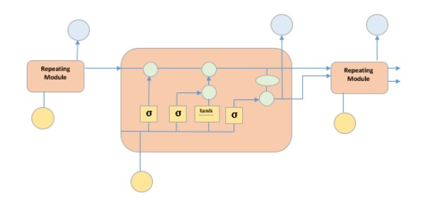
PRELIMINARY CONCEPTS
LSTM :
A Long Short-Term Memory (LSTM) is a special kind of recurrent neural network that is able to learn long term dependencies in data using a combination of four layers interacting with each other through input, output, and forget gates, and a cell state that allows for selective learning, unlearning, or retention of information without alteration through linear interactions.
Fig: LSTM

Slide 10
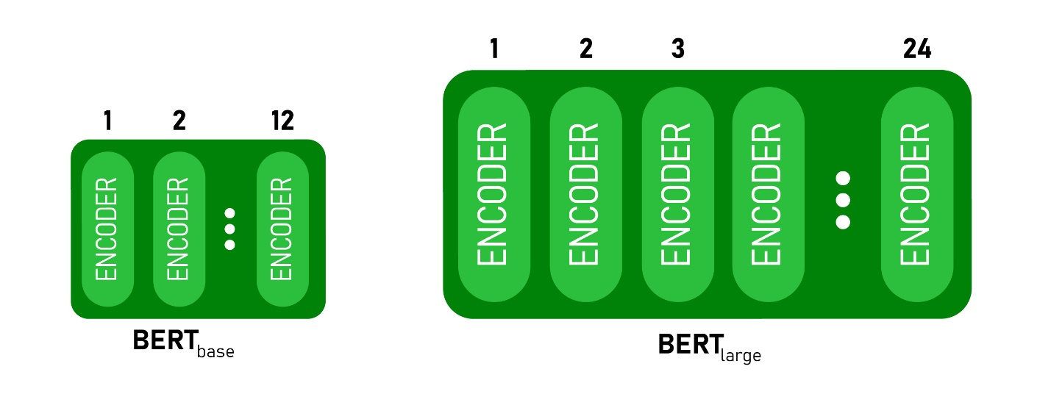
PRELIMINARY CONCEPTS
BERT :
Bidirectional Encoder Representations from Transformers (BERT) is a state-of-the-art natural language processing model developed by Google Research in 2018 that uses a transformer architecture with self-attention on the encoder side and attention on the decoder side to achieve high accuracy on a variety of NLP and NLU tasks, and is available in two sizes (BERTBASE and BERTLARGE) with different numbers of layers, hidden units, and attention heads in the encoder stack.
Fig: BERT

Slide 11
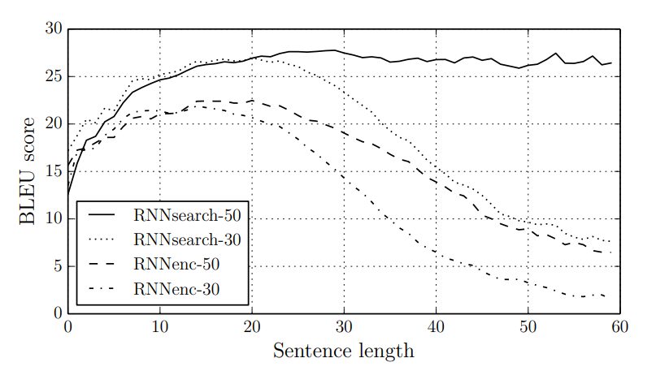
DATASET
The WMT '14 dataset was used for English-French translation and included various parallel corpora totaling 850 million words, with a combined size of 348 million words. The test set for evaluation consisted of 3003 phrases not found in the training data. The models were trained on a shortlist of 30,000 most frequent terms in each language, with all other terms assigned to a unique token. There was no additional special data preprocessing.
Fig: Dataset

Slide 12
METHODOLOGY
The purpose of this project is to train a machine translation model using the Bidirectional Encoder Representations from Transformers (BERT) algorithm, with a focus on comparing the performance of the model with different training approaches and datasets. A transformer model is trained and evaluated on English-French language pair data, using the Hugging Face API and the AutoModelForSeq2SeqLM class. The project uses the tensor2Tensor framework and the Transformer model for English-to-Czech neural machine translation, with the goal of achieving high translation quality through the use of larger batch sizes. The project also involves the use of Recurrent Neural Networks (RNN) and Long Short-Term Memory (LSTM) neural networks, and involves evaluating the performance of the model using metrics such as BLEU score and BERT score. Data preprocessing and model training and evaluation steps are detailed in the project. The model is also tested with a simple function that inputs a string of text and outputs a translated version of the text.

Slide 13
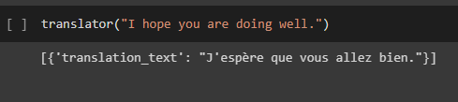
RESULT
 | Before Training | After Training
eval loss | 1.7008 | 0.9545
eval bleu | 39.4026 | 51.2316
eval bert score | 0.8593 | 0.8927
The evaluation loss, bleu-score & bert-score are given in the table. After that we have given an english sentence to our model and it has translated the sentence into french quite well. we can see details in Fig. code.
Fig: Code

Slide 14
CONCLUSION
In this paper, we present a neural machine translation model using an encoder-decoder approach, with Google Neural Machine Translation used to improve fluency and accuracy. The model uses two models, RNN Encoder-Decoder and RNNsearch, with the latter performing better at translating long sentences. The model is trained on a large data set and has an end-to-end design, allowing it to improve over time. The model also includes the concept of "zero-shot translations," which are direct translations using Google Neural Machine Translation.

Slide 15
REFERENCES
NIPS-2017-attention-is-all-you-need-Paper.
Neural Machine Translation.
Jacob Devlin, Ming-Wei Chang, “BERT: Pre-training of Deep Bidirectional Transformers for Language Understanding”, 11 Oct 2018.
St ́ephane Clinchant, “On the use of BERT for Neural Machine Transla- tion”, 27 Sept 2019 .
Dzmitry Bahdanau, “Neural Machine Translation by Jointly Learning to Align and Translate”, 1 Sep 2014.
Yoshua Bengio, “A Neural Probabilistic Language Model”, 02 April 2003.
Dzmitry Bahdanau, “Neural Machine Translation by Jointly Learning to Align and Translate”, 1 Sep 2014 .

Slide 16
REFERENCES
S. Bengio and Y. Bengio. Taking on the curse of dimensionality in joint distributions using neural networks. IEEE Transactions on Neural Networks, special issue on Data Mining and Knowledge Discovery, 11(3):550–557, 2000a.
S. Bengio and Y. Bengio. Taking on the curse of dimensionality in joint distributions using neural networks. IEEE Transactions on Neural Networks, special issue on Data Mining and Knowledge Discovery, 11(3):550–557, 2000a.
Y. Bengio and J-S. Sen ́ecal. Quick training of probabilistic neural nets by importance sampling. In AISTATS, 2003.

